Slide 1
Qualitative Data Analysis
Dirk Riehle, FAU Erlangen
NYT B03
Licensed under CC BY 4.0 International

Slide 2
Course Content and Structure
Overview
What is science?
Scientific research
Qualitative data analysis
Theory building
Theory building
Systematic reviews
Qualitative surveys
Action research
Case study research
Theory validation
Theory validation
Survey research
Controlled experiments
Comprehensive
Design science
Academia
Academic writing
Academic publishing

Slide 3
Agenda
QDA in theory building
QDA artifacts
QDA methods
Straussian coding
Quality assurance
Iterative process
Theory presentation

Slide 4
1. QDA in Theory Building

Slide 5
Qualitative Data Analysis (QDA) [1]
Qualitative data analysis is a research method
For deriving meaning from qualitative empirical data
In response to one or more research questions
Typically used in theory building and development
Inductive use → theory building
Deductive use → theory evaluation
[1] Also qualitative content analysis (German: qualitative Inhaltsanalyse)

Slide 6
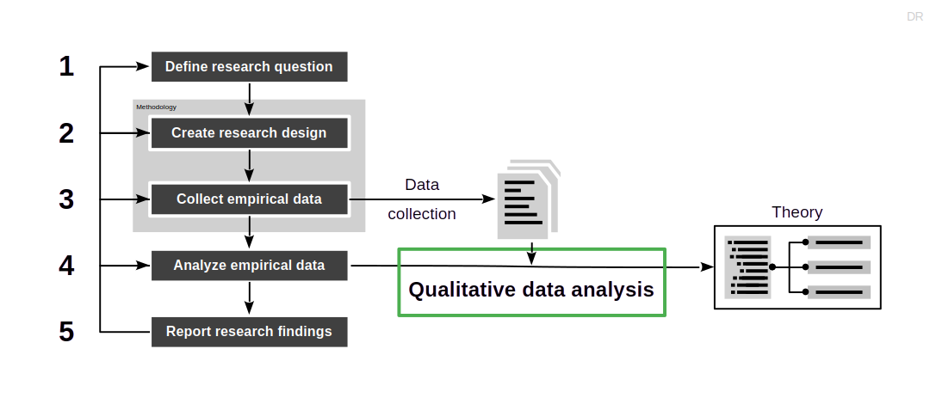
Position and Purpose of QDA in Theory Building

Slide 7
QDA in Theory Building Methodologies
Most QDA methods can be plugged into theory building methodologies
Systematic reviews
Qualitative surveys
Action research
Case study research

Slide 8
Properties of QDA
The qualitative data analysis process is
Inductive (→ theory building from data)
Structured (→ not arbitrary / random)
Quantitative (→ measurable quality)

Slide 9
2. QDA Artifacts

Slide 10
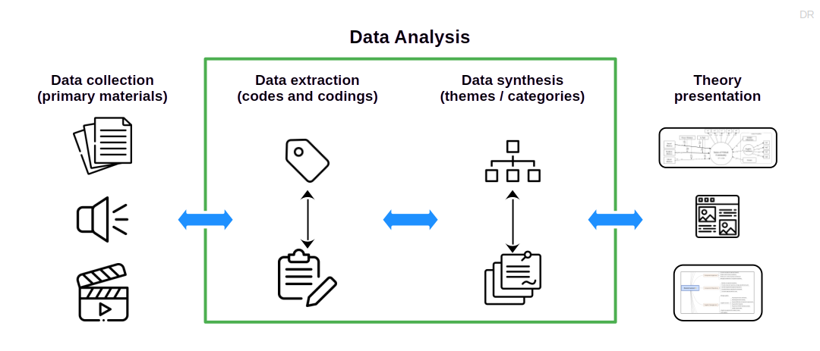
Artifacts and Activities in QDA

Slide 11
Codes and Codings
A code (also label, annotation, etc.) is
A short text (name) for an empirical observation
An open code is a code that
Originates from the primary materials through a coding
A coding is
The relationship between an open code and its origin in the data
A theme or category is a code that
Hierarchically abstracts from other codes in a code system

Slide 12
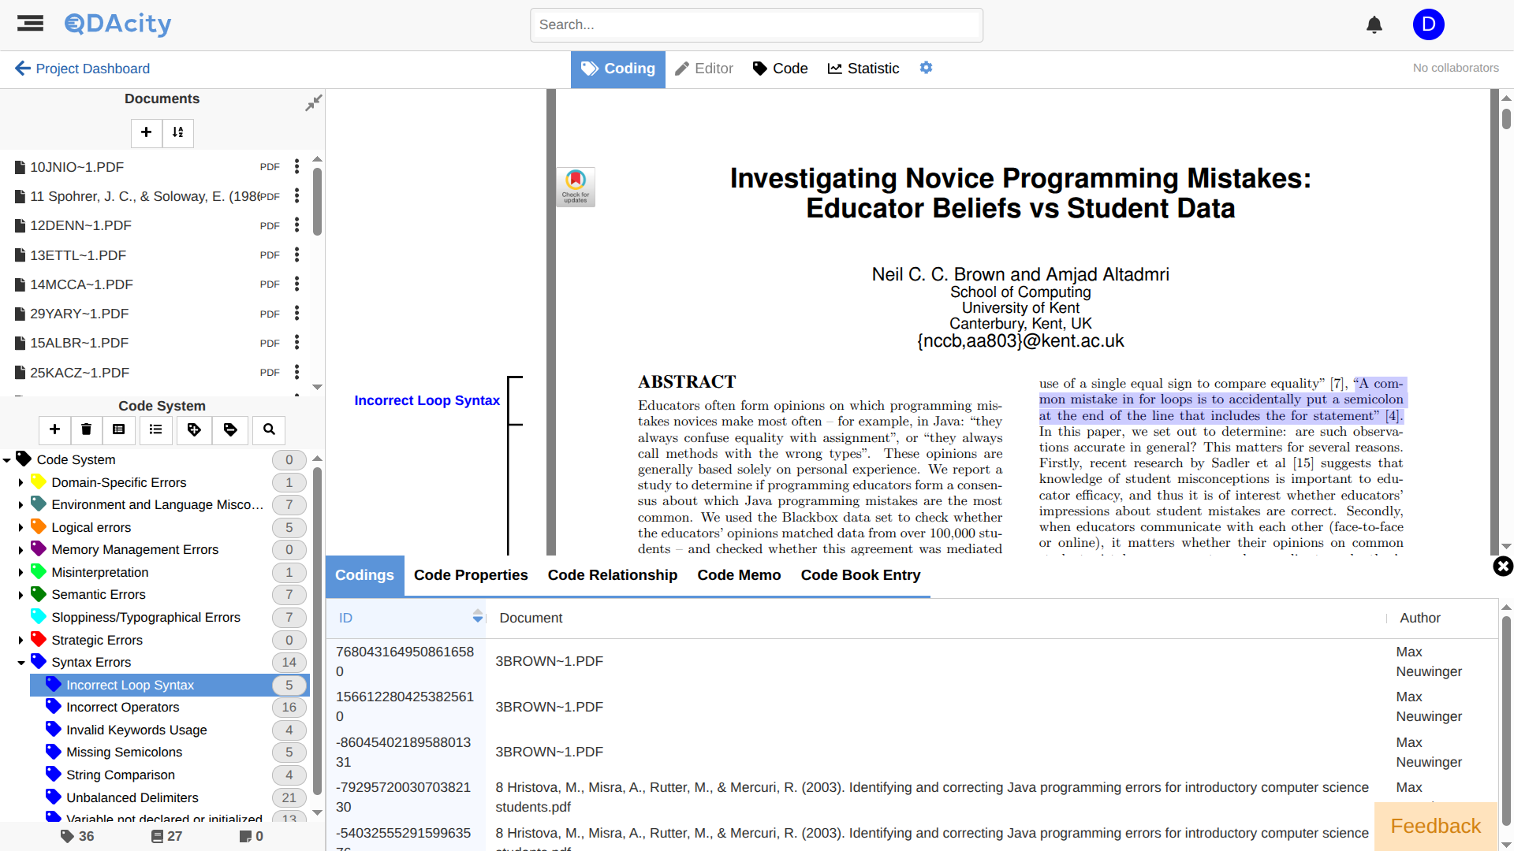
Example Code and Codings

Slide 13
Code Definition
A code definition should include
A short (one sentence) definition
A description of
When to use the code and
When not to use the code

Slide 14
Memo
A memo is
A written reflection on a code
A memo may include
Research insights and observations
Work notes for future investigations
The code itself should be defined independently of the memo

Slide 15
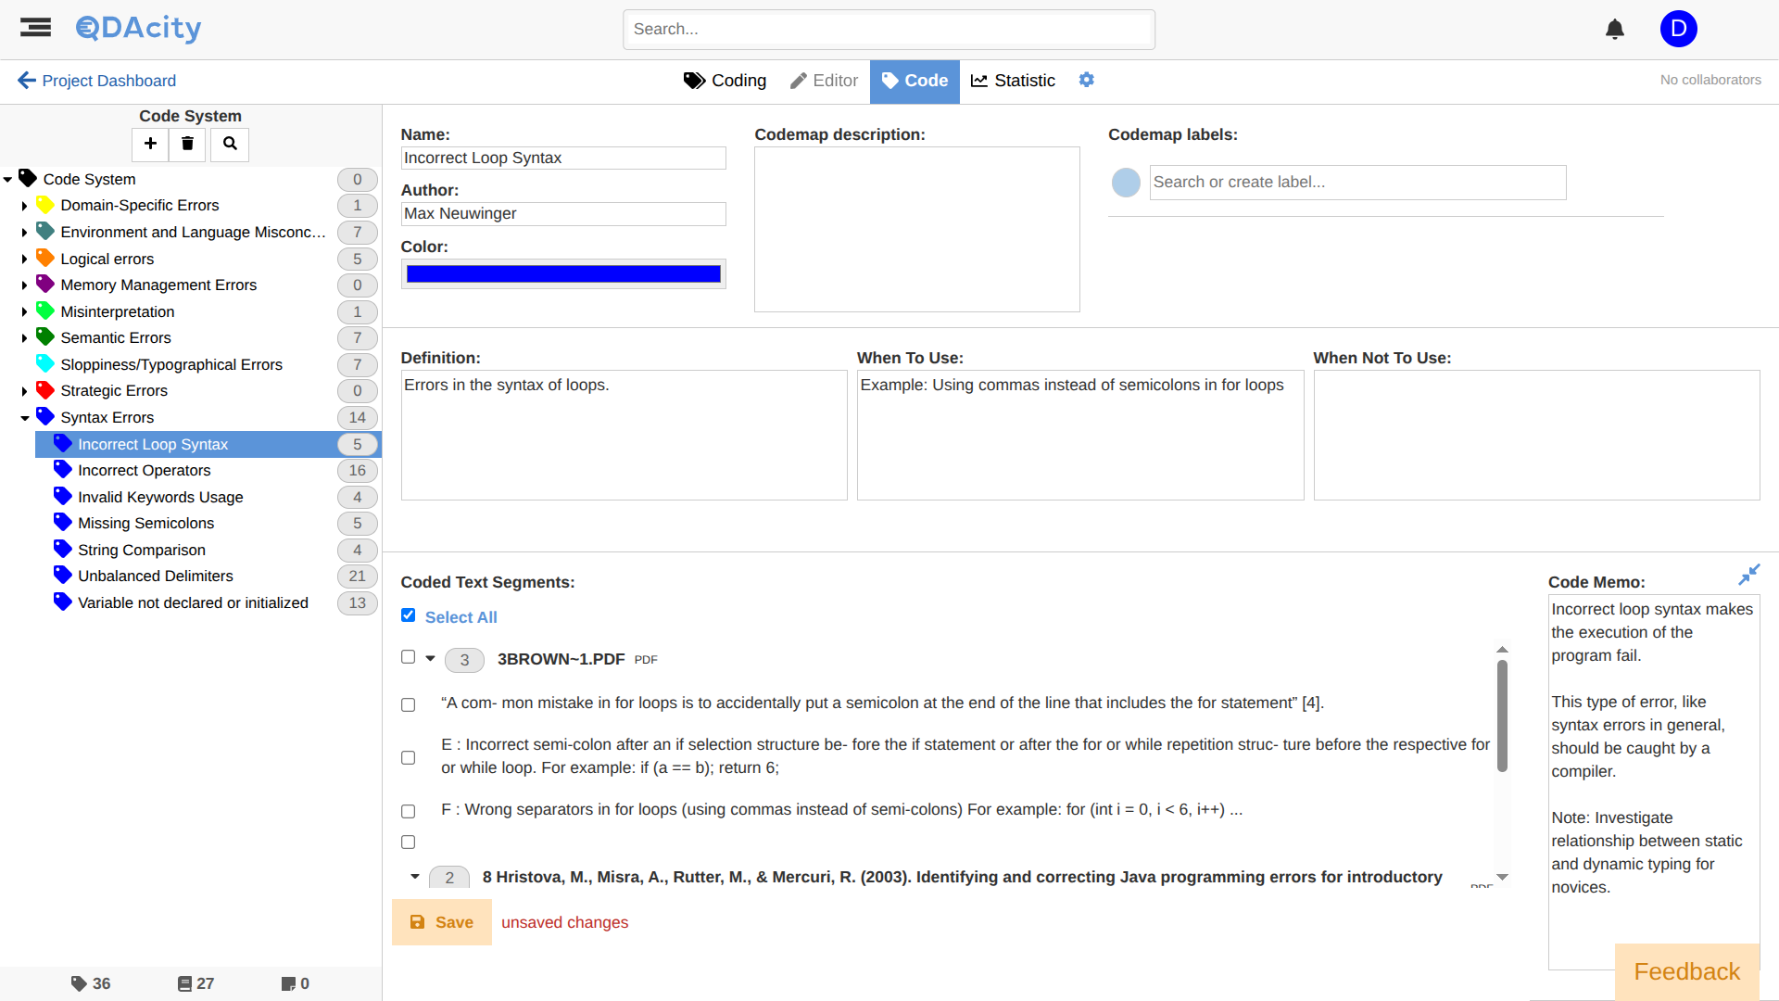
Example Code and Memo

Slide 16
Code System
A code system is
A hierarchical structure of codes intended
To capture the relationships between the codes
A code system is an expression of the theory under development
Codes represent concepts and constructs
Relationships represent hypotheses

Slide 17
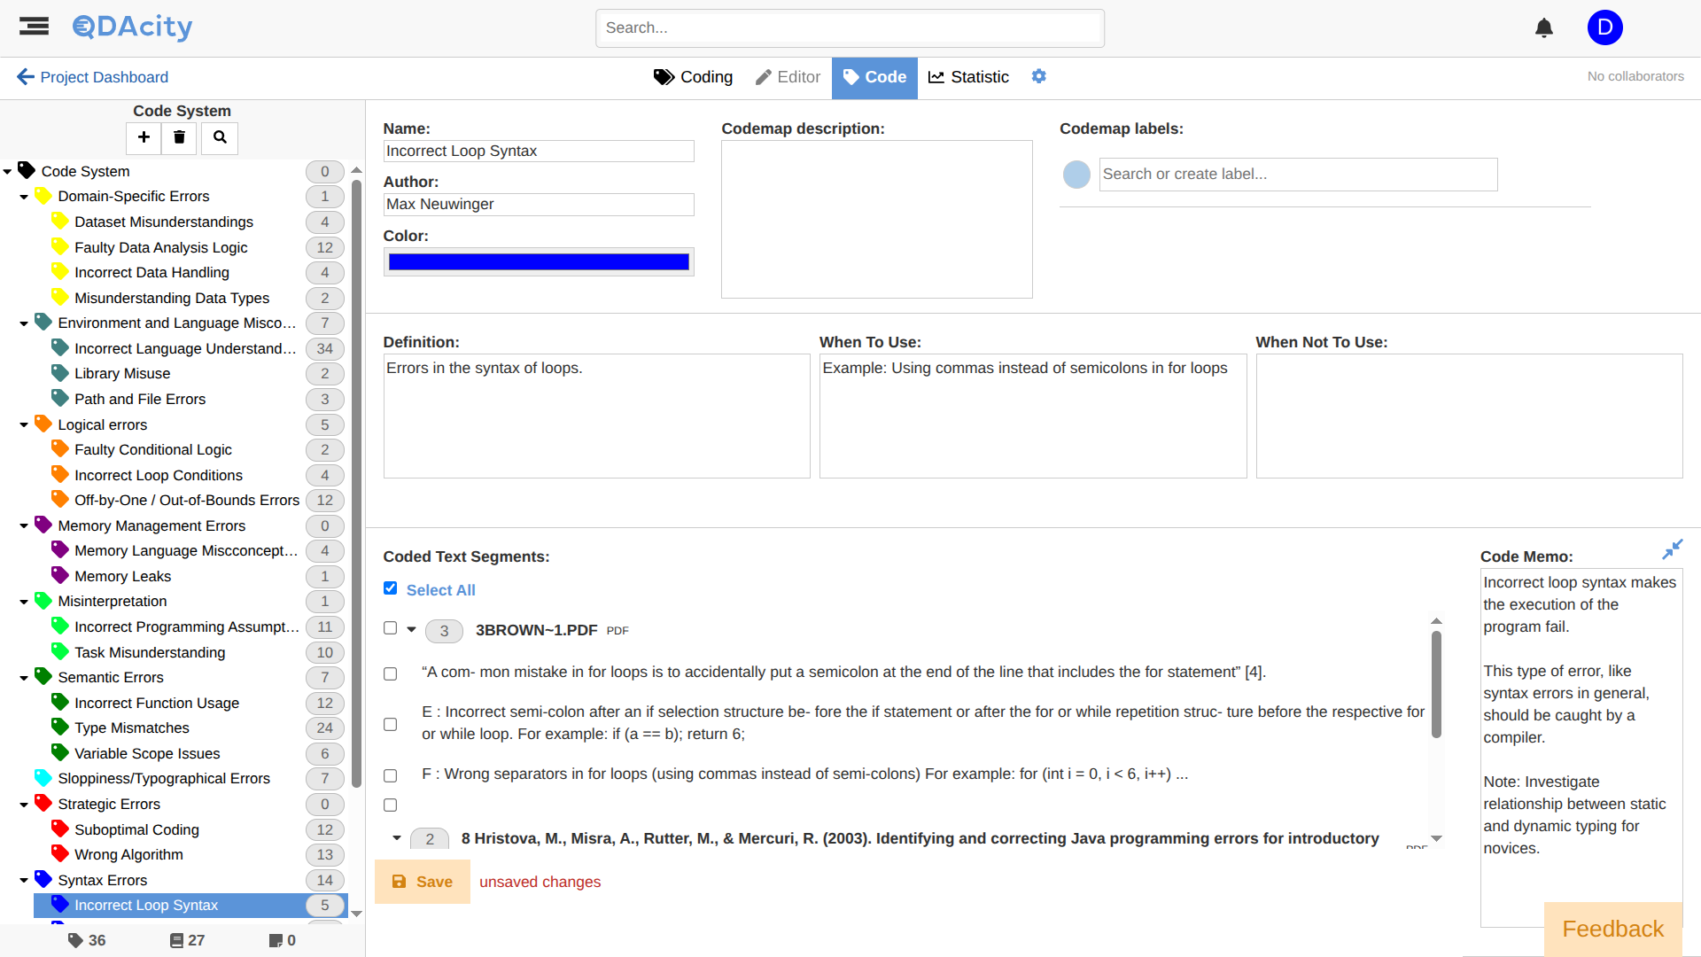
Example Code System

Slide 18
The Semantics of Hierarchy
In principle, anything goes, but …
Common patterns of hierarchical organization are
A slotting system to group similar open codes (cf. card sorting)
A grouping system for underlying themes (cf. thematic analysis)
A structuring mechanism for theoretical constructs / abstractions
Computer science students may use common modeling techniques like
Association, aggregation (part-whole), generalization/specialization
No tool (yet) allows for the formal capture of such (meta) relationships

Slide 19
Code Book
A code book documents the code system
For each code in the code system, the code book lists
The definition of the code
Instructions for when to use the code
Possible disambiguations towards other codes
An exemplary piece of data coded with the code
Beyond general documentation, a code book
Helps establish intercoder reliability of analysis

Slide 20
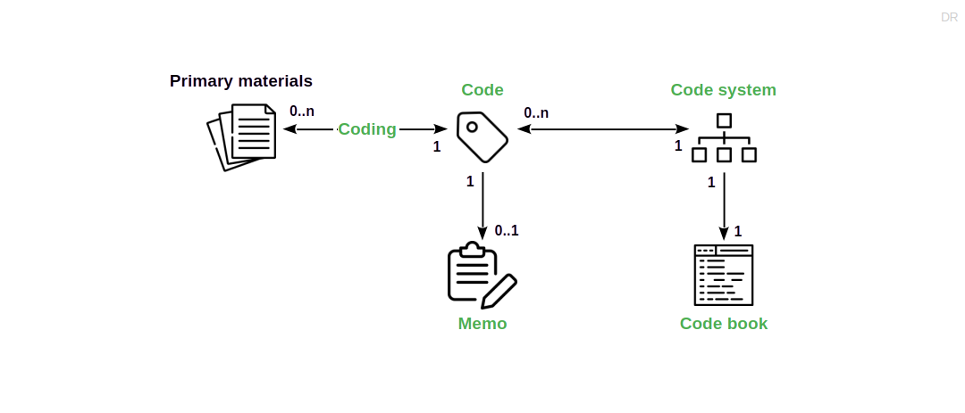
Main Artifacts in Overview

Slide 21
3. QDA Methods

Slide 22
Three Different QDA Methods
Card sorting [1]
Thematic analysis [2]
Straussian coding [3]
[1] See Hudson (2013): Card sorting.
[2] See Braun & Clarke (2012): Thematic analysis.
[3] See Corbin & Strauss (2008): Qualitative research, 3rd edition.

Slide 23
Card Sorting [1]
Analyze data
Extract data
Name item [2] and write on card
Synthesize data
Group cards with similar items
Codify theory
Name and summarize groups
[1] See Hudson (2013): Card sorting.
[2] Item, topic, theme, artifact, … depends on context and is relative to research question

Slide 24
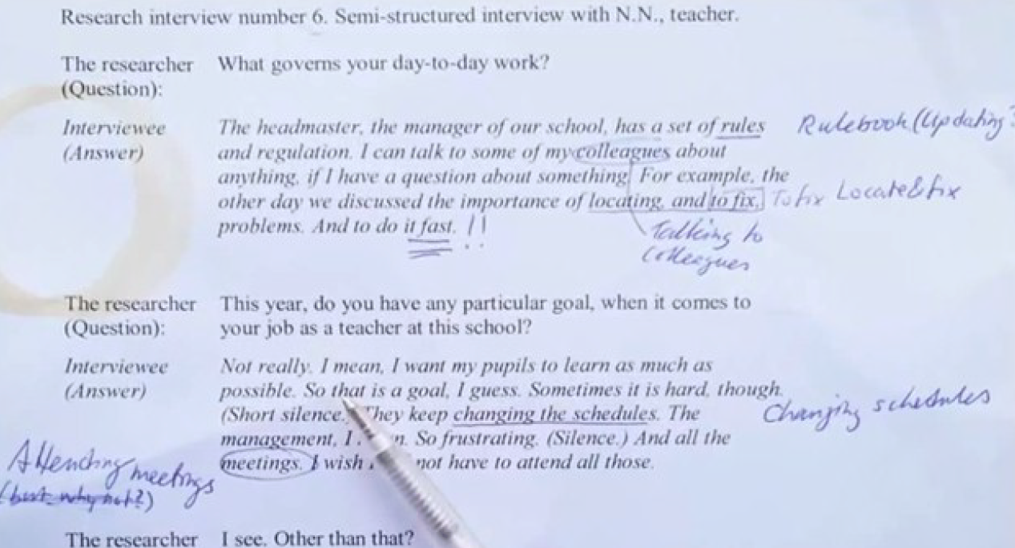
Coding, Then

Slide 25
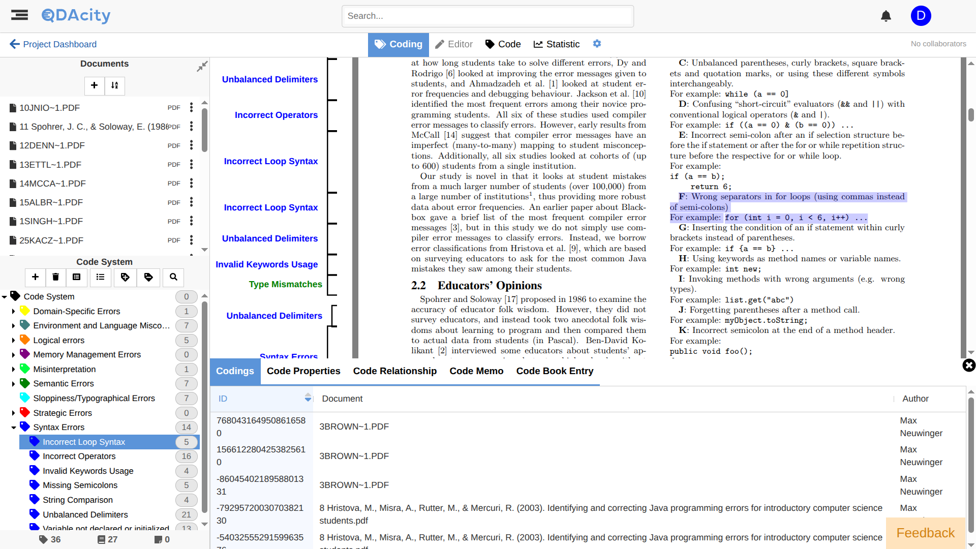
And Now (With QDAcity)

Slide 26
Thematic Analysis [1]
Analyze data
Extract data
Familiarize yourself with the data
Generate initial codes
Synthesize data
Search for potential themes
Review potential themes
Define and name themes
Codify theory
Produce the report
[1] See Braun & Clarke (2012): Thematic analysis.

Slide 27
Straussian Coding [1]
Analyze data
Extract data
Perform open coding
Synthesize data
Perform axial coding
Perform selective coding
Codify theory
Write articles
[1] See Corbin & Strauss (2008): Qualitative research, 3rd edition.

Slide 28

Grounded Theory
Grounded theory is a research methodology for theory building like qualitative surveys, etc.
Straussian coding was lifted from Corbin & Strauss’ version of grounded theory [1]
[1] See Corbin & Strauss (2008): Qualitative research, 3rd edition.

Slide 29
Artifacts and Activities in QDA Methods
 |  | Card sorting | Thematic analysis | Straussian coding
Artifacts | Codes | Items | Codes | Open codes
 | Categories | Item groups | Themes and subthemes | Concepts and categories
Activities | Extraction | Card writing | Initial coding | Open coding
 | Synthesis | Grouping and summarizing | Theme naming and defining | Axial and selective coding

Slide 30
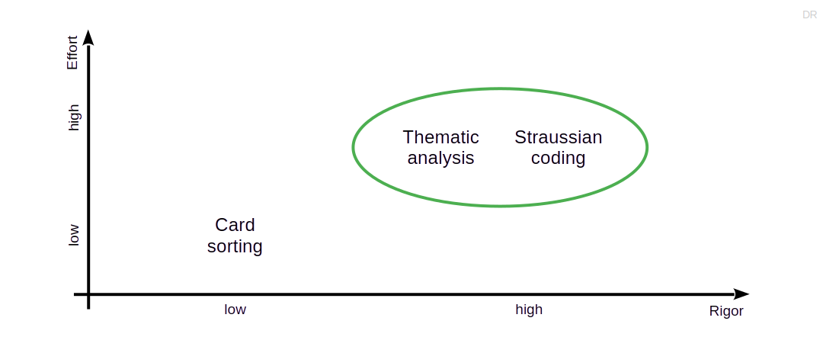
Rigor vs. Effort in QDA Methods

Slide 31
A Word of Caution
Despite my correlation and attempted homogenization
Method authors and users can be extremely picky
So in a given research project, always use the specific method

Slide 32
4. Straussian Coding

Slide 33
Open Coding 1 / 2
An open code is a code that
Represents an empirical observation
Is conceptual, i.e. represents a concept
Has a direct origin in the primary materials
Open coding is
The creation of open codes from primary materials
An in-vivo code is an open code that
Has a name taken directly from the primary materials

Slide 34
Open Coding 2 / 2
Carefully read the primary materials incrementally, repeatedly
Mark segments containing relevant information for your research question
Assign segment to existing open code or create a new one
Write memos for codes to elaborate on your observations

Slide 35
Constant Comparison
As you are coding, compare codes
Are two codes the same?
Are there subtle differences? Should the codes be split?
Then take action and refactor your code system
Implies rereading and recoding

Slide 36
Axial Coding
Axial coding is
The introduction of new codes representing concepts or constructs by
Comparing existing codes for similarities and differences
Axial coding creates a hierarchy of codes, the code system
Codes should be MECE that is
Mutually Exclusive and
Completely Exhaustive

Slide 37
Concepts and Constructs
Codes represent concepts; examples
Off-by-one error (open code)
Syntax error (axial code)
Codes represent constructs; examples
Product owner / software developer conflict (open code)
Performance incentive (axial code)

Slide 38
Selective Coding
Selective coding is
The focussing of top-level codes on the research question and
The relationship-building of top-level codes to a single core code
According to Corbin & Strauss, the theory is the single core code

Slide 39
Resulting Theory
Code systems and associated artifacts represent the theory
There is more to the theory in a researcher’s mind
It needs research articles to document this

Slide 40
5. Quality Assurance

Slide 41
General Criteria for Qualitative Research
Quality criteria based on Guba & Lincoln [1]
Credibility
Transferability
Dependability
Confirmability
Typically realized through specific practices
[1] See Guba & Lincoln (1982): Naturalistic inquiry.

Slide 42
Example Research Practices
Two example research practices
Member checking
Peer debriefing
Fairly simple and easy

Slide 43
Member Checking
Member checking is a research practice in which the researcher
Seeks feedback from data sources (participants, stakeholders) either
During data gathering (active and reflective listening) or
After analysis (asking for feedback and confirmation)

Slide 44
Peer Debriefing
Peer debriefing is a research practice in which the researcher
Subjects their work to review and critique by a peer
At multiple times during the current running project
The researcher presents and explains their work
The peer questions and critiques the work, looking for flaws
The researcher documents the session with a protocol

Slide 45
QDA-Specific Concerns
How do you know you are done?
Theory saturation
How do you know you are not winging it?
Intercoder agreement

Slide 46
Theory Saturation [1]
Theory saturation is a
Stopping criterion for qualitative data analysis
Theory saturation is reached when
Further data collection and analysis does not yield new insights
In measurable terms, the change rate of codes is zero
New data yields new codings, but no new codes
[1] Originally theoretical saturation

Slide 47
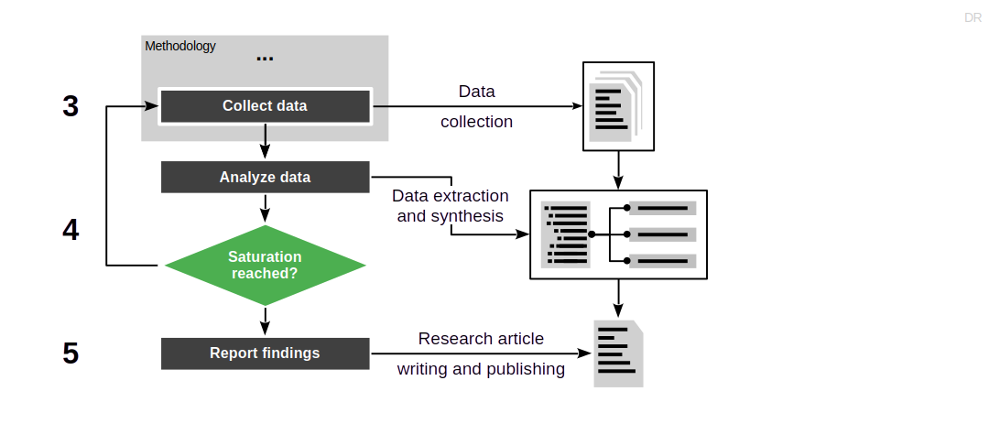
Theory Saturation in Research Process

Slide 48
Measuring Theory Saturation
Structure analysis into iterations
Use purposive sampling to seek out new data
After finishing the analysis of new data
Count the number of new codings and codes
No new codes in five iterations
Theory saturation reached

Slide 49
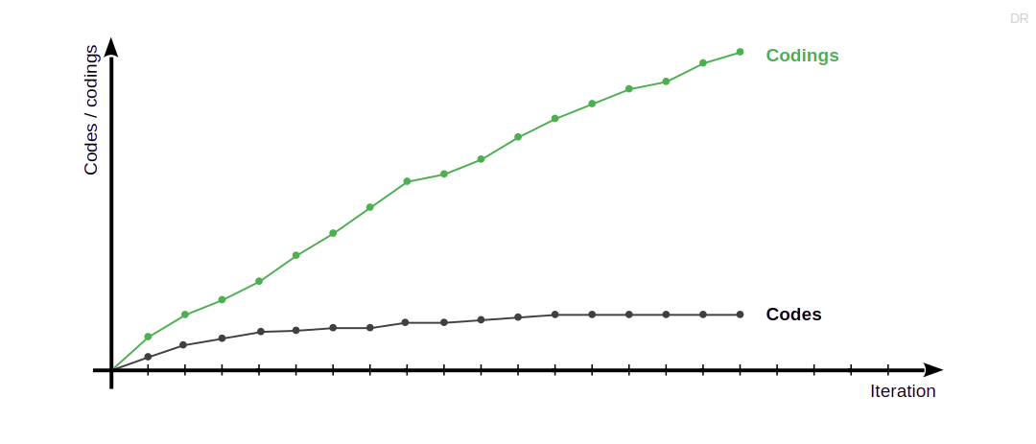
Charting of Theory Saturation by Iteration

Slide 50
Intercoder Reliability
Intercoder reliability (also: interrater reliability) is
The degree of agreement between
A primary (the original) coder and
One or more secondary coders
In other words: Is there intersubjective agreement?
And to what extent?

Slide 51
Process of Measuring Intercoder Agreement
The original coder creates the code book
The code book documents the code system
The original coder explains and discusses the code book with further coders
Further coders (usually one) code the primary materials using the code system
The intercoder agreement is the overlap/agreement of the coding sets

Slide 52
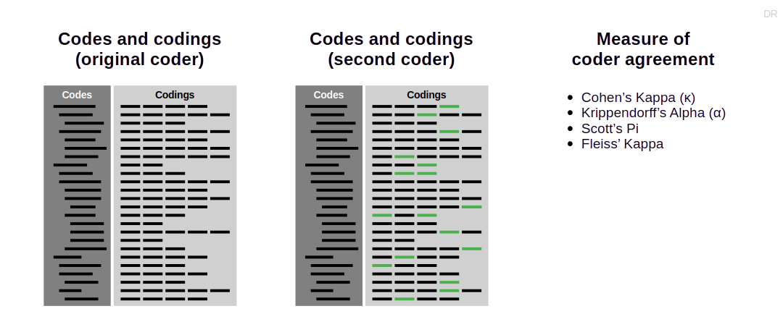
Measures of Intercoder Agreement

Slide 53
6. Iterative Process

Slide 54
Theory Building is Iterative
Theory building proceeds in iterations
Iterations incrementally answer the primary research question at hand
Triangulation and expansion improve rigor and increase relevance

Slide 55
Research Project Iteration
A research project proceeds in iterations
Each iteration provides an increment
Stopping criterion is theory saturation
Each iteration gathers new data based on insights
New data (samples) follow sampling model and strategy
The research project determines the primary methodology

Slide 56
Build-out Using Multiple Research Projects
Theory building proceeds incrementally, across many research projects
Larger research projects are composed of smaller ones
Multiple research projects allow for triangulation (rigor)
Multiple research projects expand scope (relevance)
Each research project may use a different methodology
Systematic review
Qualitative survey
Action research
Case study research

Slide 57
7. Theory Presentation

Slide 58
Theory Presentation
Prose-based descriptions
Mathematical models / equations
Structural equation models [1]
Concept matrices [2]
Handbooks [3]
[1] See Palvia et al. (2006): Research models.
[2] See Webster & Watson (2002): Analyzing the past to prepare for the future.
[3] See Riehle et al. (2025): Pattern discovery and validation (a.k.a. the handbook method).

Slide 59
Summary
QDA in theory building
QDA artifacts
QDA methods
Straussian coding
Quality assurance
Iterative process
Theory presentation

Slide 60
Thank you! Any questions?
dirk.riehle@fau.de – https://oss.cs.fau.de
dirk@riehle.org – https://dirkriehle.com – @dirkriehle

Slide 61
Legal Notices
License
Licensed under the CC BY 4.0 International license
Copyright
© 2012-2026 Dirk Riehle, some rights reserved

